Slide 1
Fixed Income & Currencies Technology (FIC)
Bond Track Application Demo
Team 11:
Pavel Calin Gabriel, Dilshaan Grewal, Vishal Vijayan, Jianpeng (George) Wang, Zhongzhou Yang

Slide 2
Aim of Project
Current Problems
The FIC team currently manages the redemption of bonds manually. The process of redeeming bonds is dependent of the quality of instrument data and timing of system processes.
This could lead to the situation that redemptions of bond not taking place

Slide 3
Aim of Project
Requirement from FIC
The FIC team is keen to have a tool that allows users to track the bonds, especially monitor on the maturity date of the bonds.
For security and compliance reasons, only permissioned users could view the bond information
With the help of the tool, the FIC team can have a transparent analysis of which bonds will be due to mature and which bonds have been matured, so that the team can quickly identify when an issue arise

Slide 4
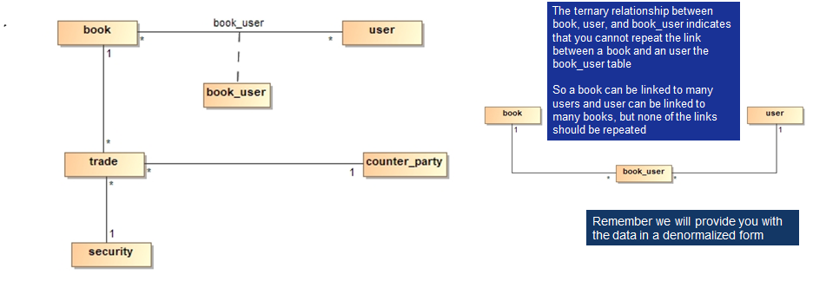
Aim of Project
Original Dataset
18 features
trade_type | trade_currency | quantity
trade_settlement_date | trade_status | trade_date
unit_price | coupon_percent | bond currency
cusip | isin | face_value(mn)
suer_name | bond_maturity_date | status
type | book_name | bond_holder

Slide 5
Architecture
Google Firebase
All bonds
Bonds maturity in +- 5 business days
Bonds belong to specific user
Trades
-
Web UI
Login Page
-
Java Application
Repository
Service
Controller
TDD
-
Security
Book
Counter Party
App User
Trade
Book User
Database

Slide 6
Final Result
The application can
Allow only authenticated users to login by using google firebase
Display all the active bonds as well as the detail of each bond, including but not limit to CUSIP, ISIN, bond issuer and bond holder
Display bonds which due for maturity within last and next 5 business days, so the user can track the bonds due to maturity
Display bonds which belong to specific user
Display all the trades executed within last and next 5 business days in detail

Slide 7
Demo
#PositiveImpact

